Slide 1

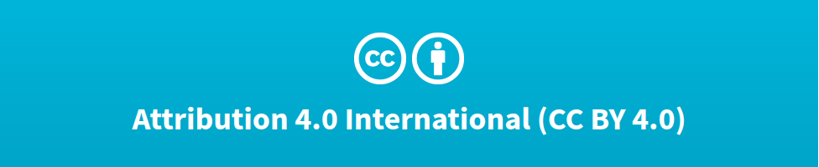

Deep Learning Design Patterns with Tensorflow 2.x
Computer Vision Workshop - Data Distributions Version: May 2020
Repo: github.com/GoogleCloudPlatform/keras-idiomatic-programmer
twitter.com/andrewferlitsch

Slide 2
Data Distributions
Overview
We will cover in this section we will cover data distributions.
Principles of Data Distribution
Out-of-Distribution Training
Step-by-Step Example

Slide 3
Model Accuracy
The five basic answers to increase the performance of the model are:
Increase training time.
Increase the depth (or width) of the model.
Add regularization.
Expand dataset with data augmentation.
Increase hyperparameter tuning.
While the above may or may not improve accuracy, the limitation ultimately is in the dataset used to train the model.

Slide 4
Distributions
The field of statistics deals with algorithms that are not deterministic.
These algorithms are called models -- which model a behavior to make an output (outcome) prediction over a probability distribution.
We will dive deeper into distributions -- in how they affect the training of a model:
Population distribution
Sub-population distribution
Sampling distribution

Slide 5
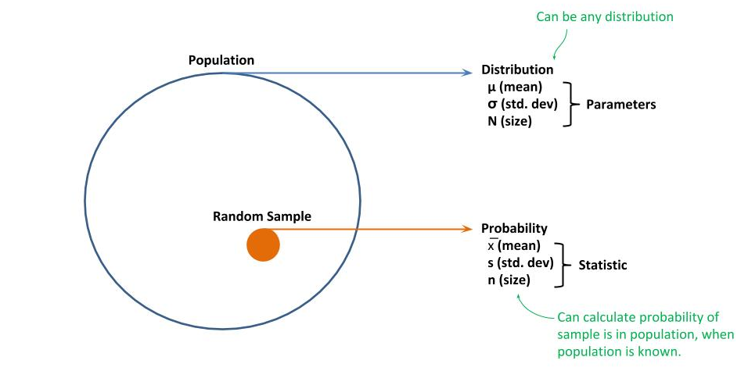
Population Distribution
If you were to build a model to predict the shoe size of an adult male in the United States, then the population distribution of this model would be all adult males in the United States, and their different shoe sizes and corresponding features (e.g., height, ethnicity, etc) would be the distribution of shoe sizes in the population.
The problem of course is that you would not have data for all adult males in the United States.
Instead, you will have some subset of data; whereby, one takes batches of the data at random, which we call a random sample, to determine a distribution within the batch.

Slide 6
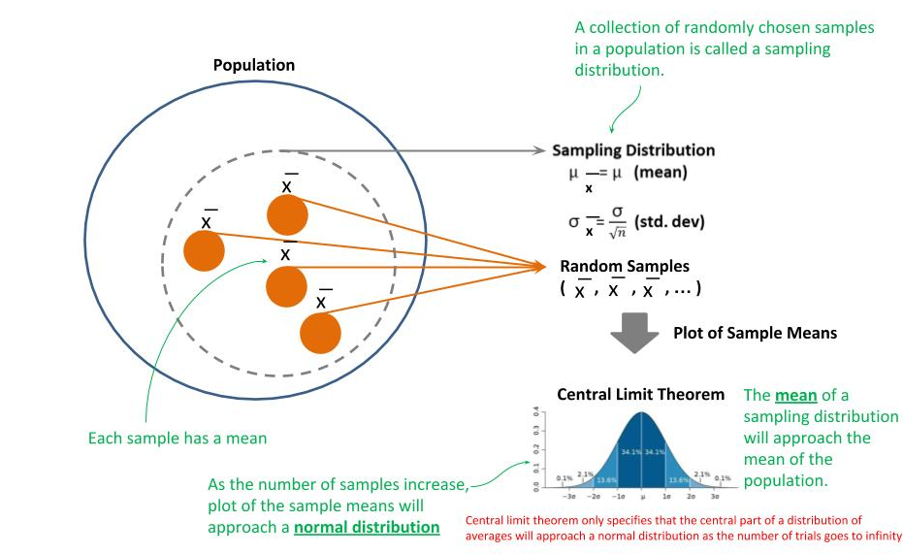
Sampling Distribution
The goal is to have enough random samples of the population; that collectively the distributions within these samples can be used to predict the distribution within the population as a whole; which is referred to as a sampling distribution.
The keyword here is “predict”, meaning we are determining a probabilistic distribution vs. a deterministic distribution.

Slide 7
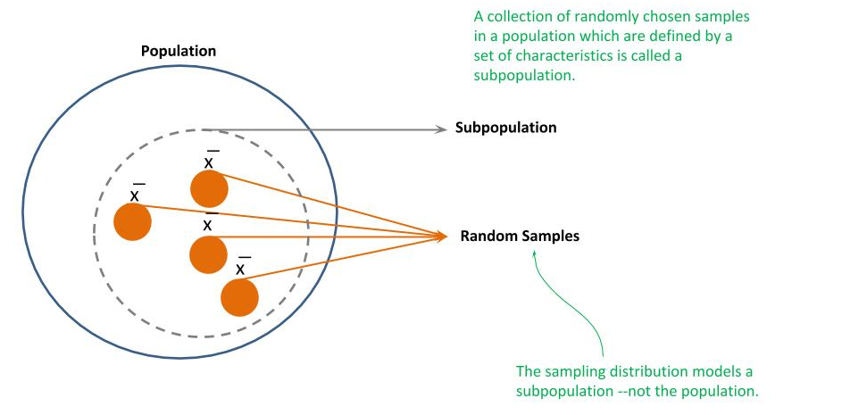
Subpopulation Distribution
Regardless of how large and comprehensive your dataset is, it is likely a sampling distribution of a subpopulation and not the population. A subpopulation is a subset of a population that is defined by a set of characteristics, which would not have the same probability distribution of the population.
Assume our samples are all from a chain of stores that specialize in selling sports shoes to professional athletes.
While with sufficient samples, we can develop a sampling distribution which is representative (predictive) of the subpopulation, it is unlikely to be representative of the population.

Slide 8
Out-of-Distribution
Demonstrate these concepts with the MNIST dataset.
MNIST is a dataset of 70,000 images of handwritten digits, proportionally balanced across each digit. It’s super easy to train a model to get near 100% accuracy on the dataset (and hence why it’s the hello world example of machine learning).
But almost all “in the wild” applications of the trained model will fail -- because the distribution of images in MNIST is a subpopulation.

Slide 9
MNIST Curated Dataset
MNIST is a curated dataset. That is, the data curator selected samples for inclusion whose characteristics meet a definition.
In the case of MNIST, each sample is a 28x28 pixel image, with the digit centered in the middle, the digit is white and the background is gray, and there is at least a 4 pixel padding around the digit.
Curated Datasets model a Subpopulation.

Slide 10
Walk Thru Example
Setting Up the Environment
Below is a code snippet we will use throughout our examples.
It includes importing the TF.Keras API for designing/training models, various Python libraries we will use, and finally the loading of the MNIST dataset that is prebuilt into the TF.Keras API.
from tensorflow.keras import Sequential from tensorflow.keras.layers import Flatten, Dense, Activation, ReLU from tensorflow.keras.layers import Conv2D, Dropout, MaxPooling2D import numpy as np import random import cv2 from tensorflow.keras.datasets import mnist (x_train, y_train), (x_test, y_test) = mnist.load_data()

Slide 11
Data Preprocessing
We need to do some initial data preparation to use it for training for a deep or convolutional neural network (CNN).
The pixel data (x_train and x_test) are in the original INT8 values (0 .. 255). We will normalize the pixel data to be between 0 and 1 as a FLOAT32.
The image data are matrices of shape Height x Width (H x W). Keras expects tensors in the shape of Height x Width x Channel. These are grayscale images, so we will reshape the train and test data to (H x W x 1).
x_test_copy = x_test x_train_copy = x_train x_train = (x_train / 255.0).astype(np.float32) x_test = (x_test / 255.0).astype(np.float32) x_train = x_train.reshape(-1, 28, 28, 1) x_test = x_test.reshape(-1, 28, 28, 1) # this will output (60000, 28, 28, 1) and (10000, 28, 28, 1) print("x_train", x_train.shape, "x_test", x_test.shape) # this will output (60000, 1) and (10000, 1) print("y_train", y_train.shape, "y_test", y_test.shape)
Set aside a copy of the test and training data before it’s been prepared (to be discussed shortly).

Slide 12
The Challenge
We create two additional test datasets as examples of what the trained model may see in the wild. These two additional datasets will contain examples that are not represented by the training data, and hence we refer to them as being out of distribution.
Inverted - The pixel data is inverted such that the images are now gray digits on white background.
Shifted - The images are shifted 4 pixels to the right, and thus are not centered anymore. Since there is at least a padding of 4 pixels, none of the digits will be clipped.
x_test_invert = np.invert(x_test_copy) x_test_invert = (x_test_invert / 255.0).astype(np.float32) x_test_shift = np.roll(x_test_copy, 4) x_test_shift = (x_test_shift / 255.0).astype(np.float32) x_test_invert = x_test_invert.reshape(-1, 28, 28, 1) x_test_shift = x_test_shift.reshape(-1, 28, 28, 1)

Slide 13
Out of Distribution Data
Original Inverted Shifted

Slide 14
DNN Training
MNIST is so easy, we can build a classifier with 97%+ accuracy with a DNN.
def DNN(nodes, dropout=False): model = Sequential() model.add(Flatten(input_shape=(28, 28, 1))) for n_nodes in nodes: model.add(Dense(n_nodes)) model.add(ReLU()) if dropout: model.add(Dropout(0.5)) dropout /= 2.0 model.add(Dense(10)) model.add(Activation('softmax')) model.compile(optimizer='adam', loss='sparse_categorical_crossentropy', metrics=['accuracy']) return model
Parameter nodes is a list. Each element is a layer and the value is the number of nodes for that layer.

Slide 15
DNN Training
For our first test, we will train the dataset on a single layer (excluding the output layer) of 512 nodes.
model = DNN([512]) model.fit(x_train, y_train, epochs=10, batch_size=32, shuffle=True, verbose=2) score = model.evaluate(x_test, y_test, verbose=1) print("test", score)
Epoch 1/10 - 5s - loss: 0.2007 - acc: 0.9409 … Epoch 10/10 - 5s - loss: 0.0163 - acc: 0.9961 test [0.11250439590732676, 0.9791]
For our first test, we will train the dataset on a single layer (excluding the output layer) of 512 nodes.
Let’s now try the model on the inverted and shifted test datasets.
score = model.evaluate(x_test_invert, y_test, verbose=1) print("inverted", score) score = model.evaluate(x_test_shift, y_test, verbose=1) print("shifted", score)
inverted [15.660332287597656, 0.0206] shifted [7.46930496673584, 0.4107]

Slide 16
DNN Training - Go Wider
Let’s increase the number of nodes in the input layer (widen) -- more nodes, better learning.
model = DNN([1024]) model.fit(x_train, y_train, epochs=10, batch_size=32, shuffle=True, verbose=2) score = model.evaluate(x_test, y_test, verbose=1) print("test", score)
For our second test, we will train the dataset on a single layer (excluding the output layer) of 1024 nodes.
Let’s now try the model on the inverted and shifted test datasets.
score = model.evaluate(x_test_invert, y_test, verbose=1) print("inverted", score) score = model.evaluate(x_test_shift, y_test, verbose=1) print("shifted", score)
inverted [15.157325344848633, 0.0489] shifted [7.736222146606445, 0.4038]

Slide 17
DNN Training - Go Deeper
Let’s increase the number of layers (deeper), more layers better learning.
model = DNN([512, 512]) model.fit(x_train, y_train, epochs=10, batch_size=32, shuffle=True, verbose=2) score = model.evaluate(x_test, y_test, verbose=1) print("test", score)
For our third test, we will train the dataset on a two layers (excluding the output layer) of 512 nodes each.
Let’s now try the model on the inverted and shifted test datasets.
score = model.evaluate(x_test_invert, y_test, verbose=1) print("inverted", score) score = model.evaluate(x_test_shift, y_test, verbose=1) print("shifted", score)
inverted [14.464950880432129, 0.1025] shifted [8.786513813018798, 0.3887]

Slide 18
DNN Training - Add Regularization
Let’s add some regularization via dropout in each layer, starting at 50% and then progressively reduce it by ½ for each layer.
model = DNN([512, 512], True) model.fit(x_train, y_train, epochs=10, batch_size=32, shuffle=True, verbose=2) score = model.evaluate(x_test, y_test, verbose=1) print("test", score)
For our fourth test, we will train the dataset with dropout for regularization.
Let’s now try the model on the inverted and shifted test datasets.
score = model.evaluate(x_test_invert, y_test, verbose=1) print("inverted", score) score = model.evaluate(x_test_shift, y_test, verbose=1) print("shifted", score)
inverted [15.862942279052735, 0.0144] shifted [8.341207506561279, 0.3965]

Slide 19
CNN Training
With convolutional layers, we should at least learn the spatial relationships. Perhaps the convolutional layers will also filter out the background as well as the whiteness of the digits. When trained, we get 98% on the test (holdout) data.
def CNN(filters): model = Sequential() first = True for n_filters in filters: if first: model.add(Conv2D(n_filters, (3, 3), strides=1, input_shape=(28, 28, 1))) else: model.add(Conv2D(n_filters, (3, 3), strides=1)) model.add(ReLU()) model.add(MaxPooling2D((2, 2), strides=2)) model.add(Dropout(0.25)) model.add(Flatten()) model.add(Dense(10)) model.add(Activation('softmax')) model.compile(optimizer='adam', loss='sparse_categorical_crossentropy', metrics=['accuracy']) return model
Parameter filters is a list. Each element is a convolutional layer and the value is the number of filters.

Slide 20
CNN Training
We trained the CNN with a single layer of 16 filters.
model = CNN([16]) model.fit(x_train, y_train, epochs=10, batch_size=32, shuffle=True, verbose=2) score = model.evaluate(x_test, y_test, verbose=1) print("test", score)
For our fifth test, we will train the dataset with a single convolutional layer of 16 filters.
test [0.05741905354047194, 0.9809]
Let’s now try the model on the inverted and shifted test datasets.
score = model.evaluate(x_test_invert, y_test, verbose=1) print("inverted", score) score = model.evaluate(x_test_shift, y_test, verbose=1) print("shifted", score)
inverted [2.1893138484954835, 0.5302] shifted [2.231996842956543, 0.5682]

Slide 21
CNN Training - Go Deeper
Now let’s try going deeper by adding another convolutional layer.
model = CNN([16, 32]) model.fit(x_train, y_train, epochs=10, batch_size=32, shuffle=True, verbose=2) score = model.evaluate(x_test, y_test, verbose=1) print("test", score)
For our sixth test, we will train the dataset with two convolutional layers of 16 and 32 filters, respectively.
Let’s now try the model on the inverted and shifted test datasets.
score = model.evaluate(x_test_invert, y_test, verbose=1) print("inverted", score) score = model.evaluate(x_test_shift, y_test, verbose=1) print("shifted", score)
inverted [1.2761547603607177, 0.6332] shifted [0.6951200264453888, 0.7679]

Slide 22
CNN Training - Augmentation
Let’s improve this by using image augmentation to randomly shift the image left or right upto 20%.
model = CNN([16, 32]) datagen = ImageDataGenerator(width_shift_range=0.2) model.fit_generator(datagen.flow(x_train, y_train, batch_size=32), steps_per_epoch= 60000 // 32 , epochs=10) score = model.evaluate(x_test, y_test, verbose=1) print("test", score)
For our seventh test, we add image augmentation to the training.
test [0.046405045648082156, 0.986]
Let’s now try the model on the inverted and shifted test datasets.
score = model.evaluate(x_test_invert, y_test, verbose=1) print("inverted", score) score = model.evaluate(x_test_shift, y_test, verbose=1) print("shifted", score)
inverted [4.463096208190918, 0.2338] shifted [0.06386796866590157, 0.9796]

Slide 23
CNN Training - Expand Distribution
Let’s now tackle training the model to filter out the background and whiteness of the digits.
We take 10% of the training data (x_train_copy[0:6000]) and invert it like we did with the test data. Why 10% instead of the whole training data? When we want to train a model to filter out something, we generally can do it with as little as 10% of the distribution of the entire training data.
x_train_invert = np.invert(x_train_copy[0:6000]) x_train_invert = (x_train_invert / 255.0).astype(np.float32) x_train_invert = x_train_invert.reshape(-1, 28, 28, 1) y_train_invert = x_train[0:6000] x_combine = np.append(x_train, x_train_invert, axis=0) y_combine = np.append(y_train, y_train_invert, axis=0)
We combine the original training data with the additional inverted training data by appending the two training sets together (both x_train --the data, and y_train --the labels), for a total of 66,000 images (vs. 60,000) in our training set.
Not use the inverted “test” data

Slide 24
CNN Training - Expand Distribution
Let’s see what happens when adding inverted training samples. Do we learn to filter out the background color?
model = CNN([16, 32]) datagen = ImageDataGenerator(width_shift_range=0.2) datagen.fit(x_train_combine) model.fit_generator( datagen.flow(x_combine, y_combine, batch_size=32), steps_per_epoch= 66000 // 32 , epochs=10) #D score = model.evaluate(x_test, y_test, verbose=1) print("test", score)
For our eght test, we train with the expanded distribution.
test [0.04763028650498018, 0.9847]
Let’s now try the model on the inverted and shifted test datasets.
score = model.evaluate(x_test_invert, y_test, verbose=1) print("inverted", score) score = model.evaluate(x_test_shift, y_test, verbose=1) print("shifted", score)
inverted [0.13941174189522862, 0.9589] shifted [0.06449916120804847, 0.979]

Slide 25
Final In the Wild Test
As a final test, I randomly selected “in the wild” images of a hand-drawn single digit from a Google image search. These included images which were:
colored,
drawn with a felt pen,
a paint brush, a
nother with a crayon drawn by a young child,
etc.
After I did my “in the wild” testing, I got only 40% accuracy with the above trained CNN.
Presume you developed a model for use in a factory to detect defects in parts, where the camera is in a fixed position and perspective over a gray colored conveyor belt, with ridges running down it. All works well until one day the conveyor belt is replaced and the owner replaces it with a nice yellow smooth belt to add some color to the factory, and now the defect detection model fails. What happened?

Slide 26
THANK YOU FOR WATCHING
Google Cloud AI Developer Relations AI Training

Slide 27
Data Distributions - Lab Exercise #XX
Optional Code Lab - Get Familiar with Data Distributions
Deep Learning Design Patterns - Workshop - Chapter 8.ipynb

